Slide 1
Thematic classification system
Sonego Orel - 318253127
Sharifi Itay - 207107251

Slide 2
General Explanation
The product is based on machine learning, which knows to catalog headlines for articles by financial and entertainment topics.
The data that the model has been trained accumulated from the internet sites “Yahoo” and the social network “Twitter”.

Slide 3
The steps
Research assumption
Data acquisition
Data handling
EDA
Advanced data analysis
Assimilation in the field

Slide 4
The steps
Defining the problem
Research assumption
Data acquisition
Data handling
EDA
Advanced data analysis
Intention to solution
Assimilation in the field
Pre preparation for the solution
solution

Slide 5
The steps
Data Acquisition
Data Cleaning
EDA
Machine Learning

Slide 6
The research assumption
As can be seen on these websites there is a thematic classification, probably manual
The question arises - is it possible to catalog headlines of various news items by topic:
Entertainment
Finance
In future - use of an automatic prediction mechanism.

Slide 7


Data acquisition
API
Use of information from Twitter pages
Yahoo Finance
Yahoo Entertainment
Crawling – selenium
Use of information from the sites
Yahoo Finance
Yahoo Entertainment

Slide 8

Important points in data collection
There is tremendous importance regarding the quantity and quality of the data
We need to pay attention to the amount of data and how to handle it:
1. Reading the all entire page (with scrolling).
2. Accumulation of 100 titles as GT for tagging at least
3. The quality of the data and its arrangement in a table in CSV format.
4. Removing unnecessary data.

Slide 9
Data cleaning
The "data clearing" phase is a necessary step in favor of the order, organization and quality of the data.
The data clearing process:
Unnecessary data cleaning (for example - advertisements, pictures, etc.) that we deleted.
Removal of sections in Hebrew by a dedicated function.
Remove rows that contain missing sections in the data collection table

Slide 10
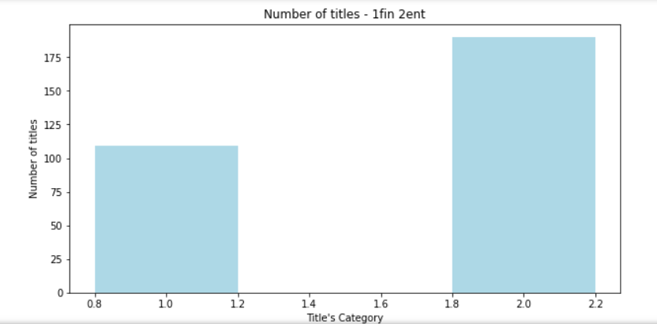
EDA
We have given maximum importance to the amount of the data, and we think that in the end it is necessary to represent the segmentation clearly.
During the study - we noticed that when there was an inequality in the amounts of the data, we received an inaccurate model.

Slide 11

Advanced data analysis
We used the mechanism - "guided learning“.
Data Analysis - Content Analysis:
Semantics analysis
This was made possible by the “ML” model - which is based on the capabilities of the SkLearn library.

Slide 12
Machine learning
test
20% of all labeling was taken in favor of Test-Set
The model tests its results on the test to obtain success metrics:
Recall
Precision
Accuracy
The results of the comparison were presented in appropriate graphs for the convenience of the user / researcher

Slide 13
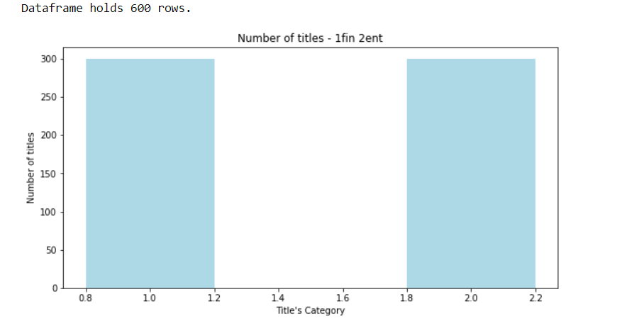
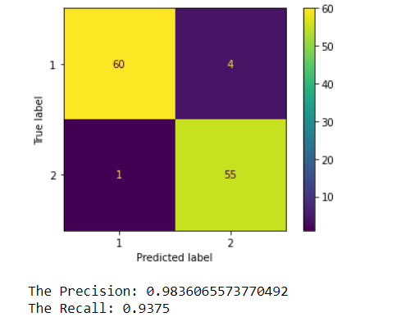
Results of the models - Yahoo & twitter

Slide 14
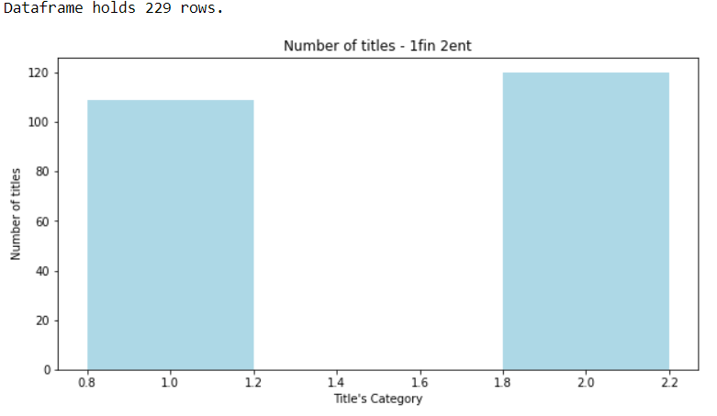
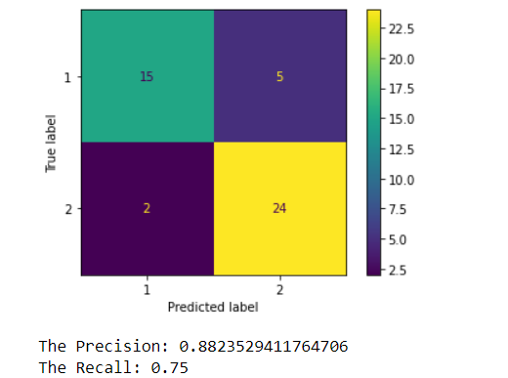
Results: Yahoo - Site

Slide 15
Details about the various files
get_tweets_by_username
Twitter API interface.
Import all tweets from 2 specific Twitter pages
Creating 2 CSV files:
finance_twitter.csv
entertainment_twitter.csv
get_yahoo_finance_selenium
Importing all the information from a Yahoo finance by Selenium function
Export the information to a file – “yahoo_data_selenium_finance.csv”
get_yahoo_ent_selenium
Import all the titles from Yahoo entertainment by Selenium function
Export the topics to a file – “yahoo_data_selenium_ent.csv”

Slide 16
Details about the various files
preprocessing_data_and_model_tweeter
Read the data from the CSV files read from the Twitter API
Arranging the data and cleaning it
Create a CSV file that contains the unified raw data- twitter_data_2_categories_clean.csv
Model training and presenting its results on the previously constructed test.
preprocessing_data_and_model_yahoo_selenium
Read the data from the CSV files read using crowling - Selnium from Yahoo
Arranging the data and cleaning it
Create a CSV file that contains the unified raw data- yahoo_data_2_categories_clean.csv
Model training and presenting its results on the previously constructed test.

Slide 17
Bibliography
The research was based on data collection and search from the various sites
The data has been collected from the sites:
Yahoo – Crawling
Twitter – API
Additional knowledge we used in this project acquired during the studies in the course "Introduction to Data Science"

Slide 18
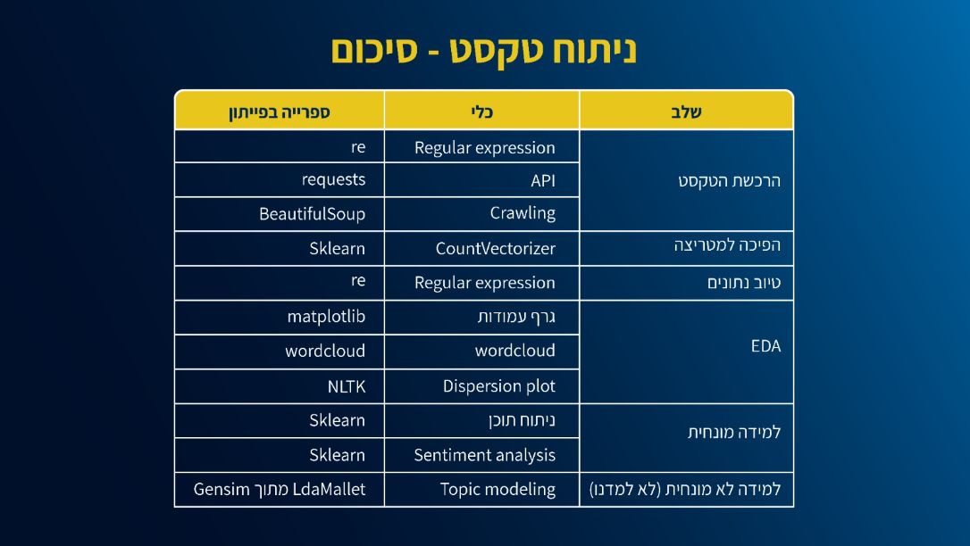

Slide 19
References

